Slide 1


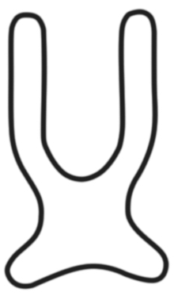
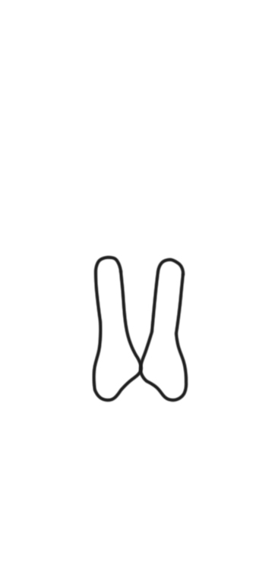
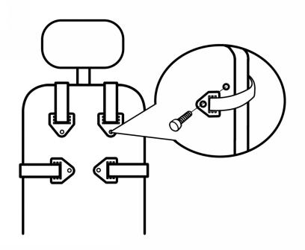
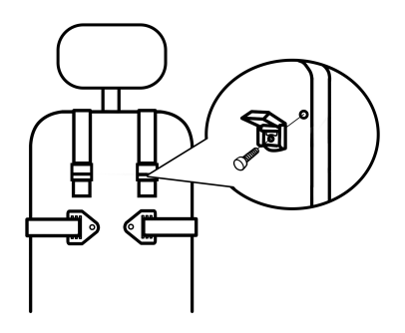
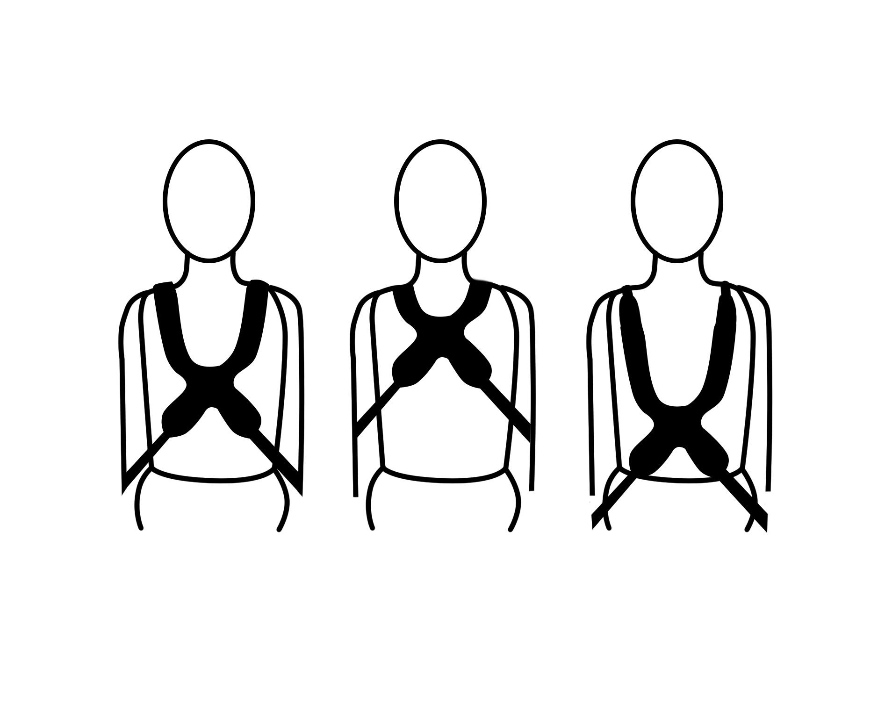
Positioning harness ,belts
Installation and user’s instructions
[ Installation of upper body positioning harness ]
Contoured Style Shoulder Harness
Full Classic
Shoulder Harness
H-Shoulder Harness
A) PACKAGE CONTENTS
• Shoulder harness
• Mounting hardware
B) INSTALLATION REQUIREMENTS
1. Wheelchair or Seat System with a solid back support
2. Mounting screws, Ø5-6mm (3/16 - 1/4”), with a minimum pullout strength of 90kg / 200lbs.
Optional fitting (available for users up to 75kg)
C) INSTALLATIOIN STEPS:
Step 1. Make sure the wheelchair User sit down on the seat with correct posture.
Step 2. Place the shoulder harness pads on the sternum and pass the upper straps cross the shoulders. Then place the lower straps through the trunk or lumbar.
Step 3. Attach upper and lower straps to the backrest with mounting hardware.
Step 4. Adjust harness position up/down to distribute pressure evenly across the ribcage and shoulders.
D) SAFETY CHECK
When properly positioned in wheelchair, have user lean forward and check whether the harness fit well side to side.
Check for:
1. Buckles and Adjustment straps function normally.
2. Comfort: If rubbing the user’s neck, relocate the upper straps.
3. Position: If the harness pads are too high or too low, adjust the straps.
If the harness is adjusted too tight, it may restrict respiration and increase pressure across the shoulders and chest.
If the harness is adjusted too loose, it cannot achieve its intended purpose, and it may allow the user to slip down which might make the User be at risk of strangulation.
Correct
Too Tight
Too Low

Slide 2
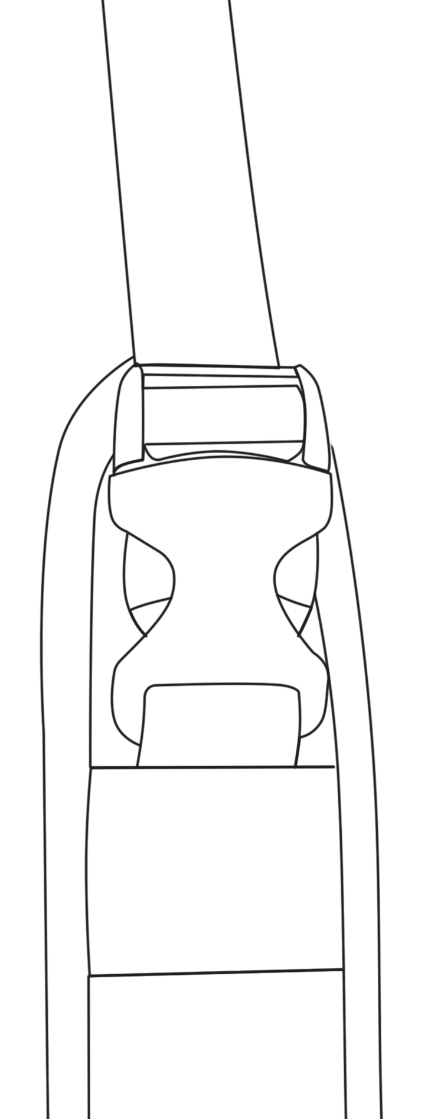
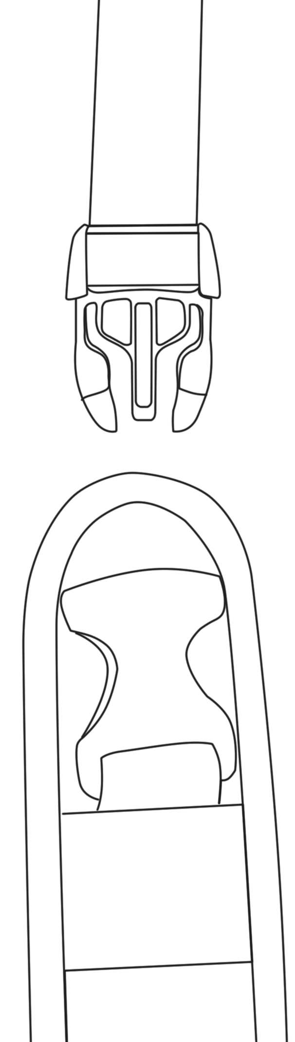
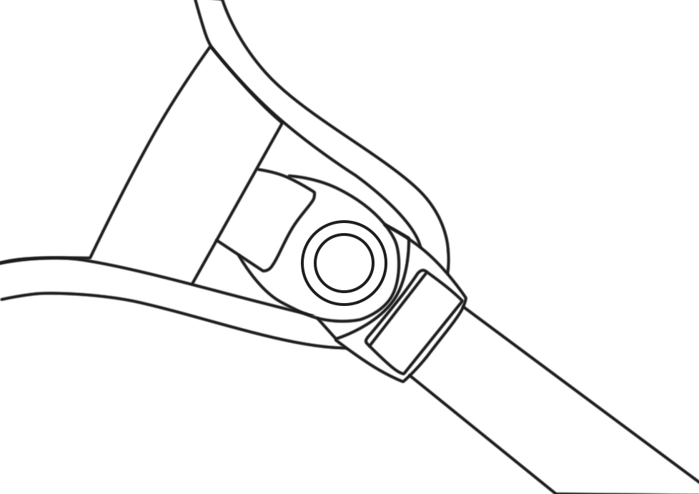
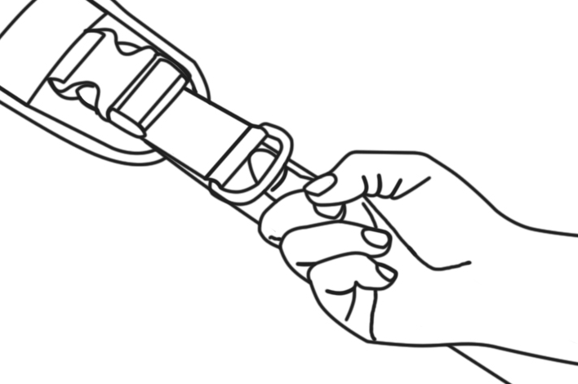
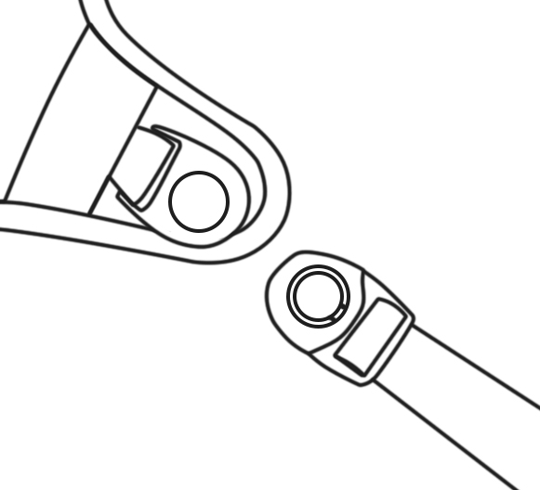
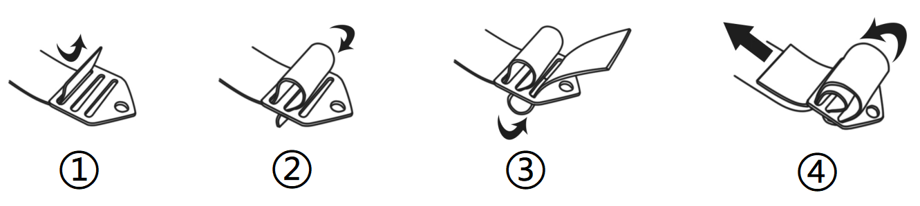

Positioning harness ,belts
Installation and user’s instructions
[ Buckle release ]
PUSH
PULL
PUSH
Plastic buckle
Plastic swivel buckle
Pull D-ring to adjust the length of the strap.
[ Warning ]
The metal mounting parts are installed as shown in the figure.
Thoroughly read and understand the information in this instructions before attempting to use this product. If the procedures and instructions in this product manual are not followed, it may cause serious injury to the user.
1) WARNING! This product should be prescribed and installed by qualified professionals.
2) WARNING! All positioning harnesses and belts are designed for postural positioning and individual security only, not as a method of restraint. Users must continue to practice regular pressure relief activities and skin integrity checks, not only where this product contacts, but also in primary pressure-bearing areas such as the sacrum, legs, and buttocks. If increased skin redness or irritation occurs, discontinue use and consult your physician or seating specialist. Also, the products need to be adjusted periodically to allow for users’ growth, changes in clothing or in their disability requirements.
3) WARNING!This product should be the first thing to be secured after sitting in the wheelchair, and the last item to be released or removed
before the User leaves the wheelchair. Accidental release of this product can allow the user to slip down or fall forward.
4) WARNING!If the user is trapped in the chair in an emergency, it may be dangerous for the user not to be able to release it on his own.
5) WARNING!If the user's physical or cognitive abilities prevent them from safely operating the harness, then the caregiver must be present at all times during its use. Ensure that all caregivers know how to properly adjust and unclip the product.
6) WARNING! This Upper Body Positioning Harness & Belt must be properly fitted to support the user’s trunk and shoulders without causing injury.
[ Maintenance ]:
Inspect this product regularly for signs of wear in the buckles, stitching, webbing & pads. Immediately remove this product from use when any condition develops that might make operation unsafe, contact your supplier for qualified repair or replacement. Do not alter or repair by unqualified persons.Customers modifying or altering our or products, or using them in conjunction with products from other manufacturers, do so at their own risk.
[ Cleaning ]:
Warm machine wash 60°C (140°F). Tumble dry low or drip dry. Do not bleach or iron.
Placing the harness/belt inside a laundry bag to prevent damage to the harness/belt and washing machine/dryer.
[ Warranty statement ]:
This product is warrantied to be free of defects in materials and workmanship for 5 year from the date of purchase for the original consumer purchaser.This warranty does not cover this product failure due to owner misuse or negligence, or normal wear and tear.
[ Disposal ]:
When a product reaches the end of its lifetime, it should be separated by material type so that the parts can be recycled and disposed of safely.
[ Intended use ]
This product should only be used for positioning a person in a wheelchair. Do not use this products for any purpose other than their intended use.

