Slide 1

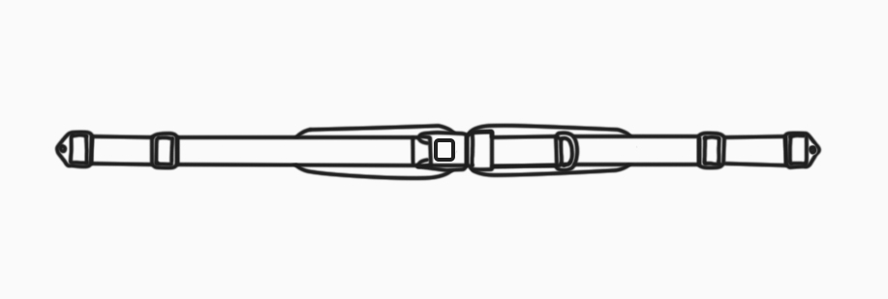
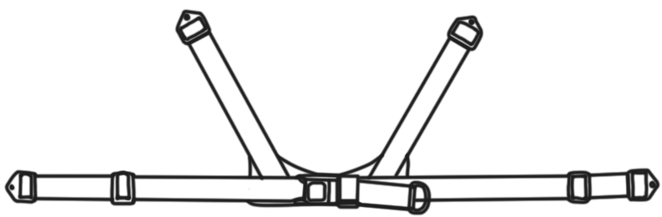
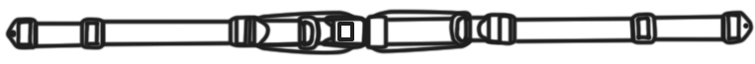
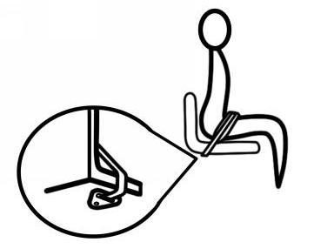
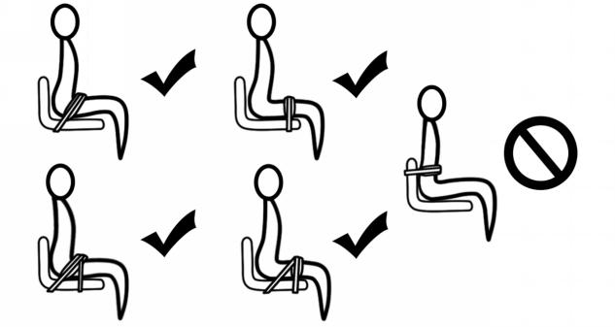
Positioning harness ,belts
Installation and user’s instructions
[ Installation of pelvic support belts]
Two Point Single Pull Padded Pelvic Belts
Two Point Dual Pull Padded Pelvic Belts
Four Points with V-Contoured Style Belt
A) PACKAGE CONTENTS
• Two-Points or Four-Points Pelvic belt
• Mounting hardware
B) INSTALLATION STEPS
1. Choose the most suitable belt for users according to different clinic advice.
2. Attach to the seating system or wheelchair frame with mounting hardware at the proper positions.
3. Tighten the belt until it is comfort but secure. Refer to the picture below.
C) ADJUSTMENT
Step 1.With the user correctly seated, check the fit of the belt. It should be snug so the user is secure. Step 2.Small adjustments can be done by using the D-ring tightening straps.
Step 3.Large adjustments in fit can be done by using the mounting straps.
D) SAFETY CHECK
When properly positioned in wheelchair, have user lean forward and check whether the Pelvic belt fit well side to side.
Check for:
1. Buckles and Adjustment straps function normally.
2. Comfort: If rubbing the user’s pelvis, relocate the pelvic belt .
3. Position: If the Pelvic belt are too high or too low, adjust the straps.

Slide 2
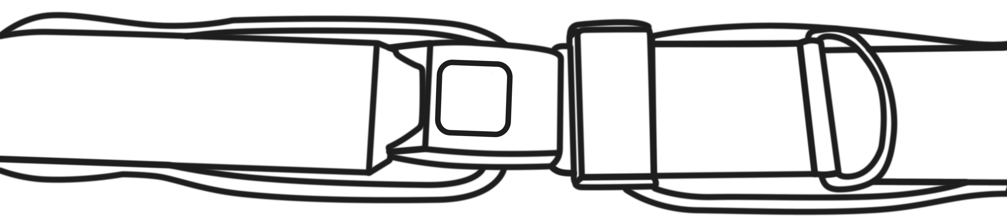
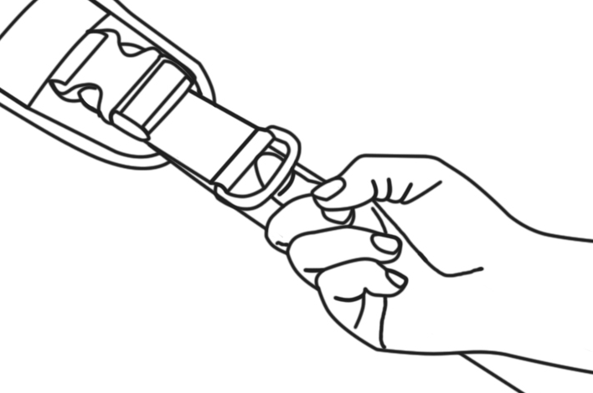
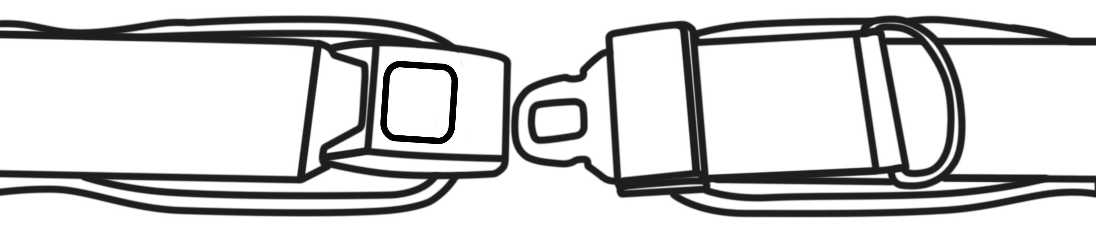
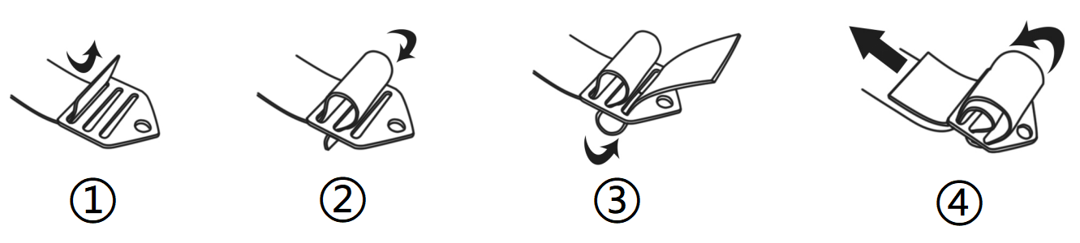

Positioning harness ,belts
Installation and user’s instructions
[ Buckle release ]
PRESS
PULL
Press the middle to unlock the metal in-line buckle
Pull D-ring to adjust the length of the strap.
[ Warning ]
The metal mounting parts are installed as shown in the figure.
Thoroughly read and understand the information in this instructions before attempting to use this product. If the procedures and instructions in this product manual are not followed, it may cause serious injury to the user.
1) WARNING! This product should be prescribed and installed by qualified professionals.
2) WARNING! All positioning harnesses and belts are designed for postural positioning and individual security only, not as a method of restraint. Users must continue to practice regular pressure relief activities and skin integrity checks, not only where this product contacts, but also in primary pressure-bearing areas such as the sacrum, legs, and buttocks. If increased skin redness or irritation occurs, discontinue use and consult your physician or seating specialist. Also, the products need to be adjusted periodically to allow for users’ growth, changes in clothing or in their disability requirements.
3) WARNING!This product should be the first thing to be secured after sitting in the wheelchair, and the last item to be released or removed
before the User leaves the wheelchair. Accidental release of this product can allow the user to slip down or fall forward.
4) WARNING!If the user is trapped in the chair in an emergency, it may be dangerous for the user not to be able to release it on his own.
5) WARNING!If the user's physical or cognitive abilities prevent them from safely operating the harness, then the caregiver must be present at all times during its use. Ensure that all caregivers know how to properly adjust and unclip the product.
6) WARNING! This pelvic support belts must be properly fitted to stabilizing the user’s pelvis .
[ Maintenance ]:
Inspect this product regularly for signs of wear in the buckles, stitching, webbing & pads. Immediately remove this product from use when any condition develops that might make operation unsafe, contact your supplier for qualified repair or replacement. Do not alter or repair by unqualified persons.Customers modifying or altering our or products, or using them in conjunction with products from other manufacturers, do so at their own risk.
[ Cleaning ]:
Warm machine wash 60°C (140°F). Tumble dry low or drip dry. Do not bleach or iron.
Placing the harness/belt inside a laundry bag to prevent damage to the harness/belt and washing machine/dryer.
[ Warranty statement ]:
This product is warrantied to be free of defects in materials and workmanship for 5 year from the date of purchase for the original consumer purchaser.This warranty does not cover this product failure due to owner misuse or negligence, or normal wear and tear.
[ Disposal ]:
When a product reaches the end of its lifetime, it should be separated by material type so that the parts can be recycled and disposed of safely.
[ Intended use ]
This product should only be used for positioning a person in a wheelchair. Do not use this products for any purpose other than their intended use.

