Slide 1

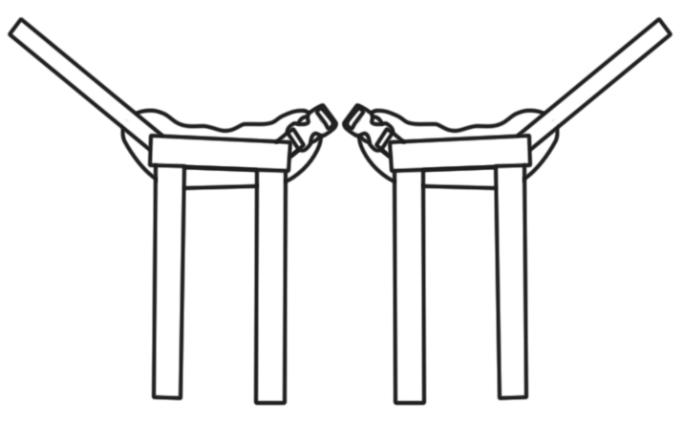
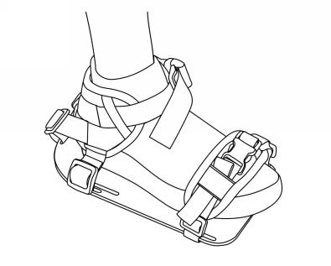
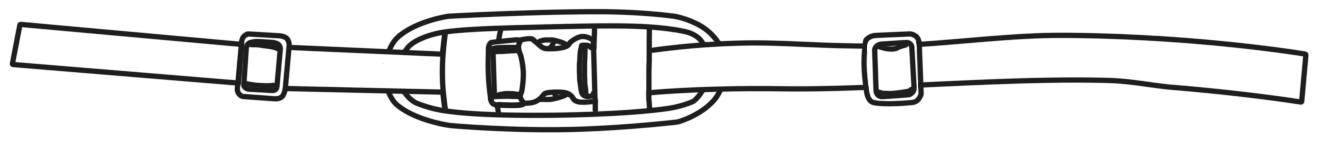
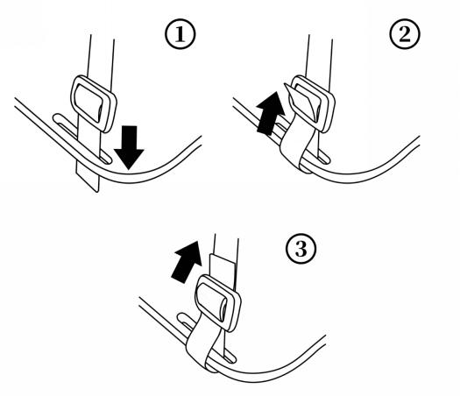
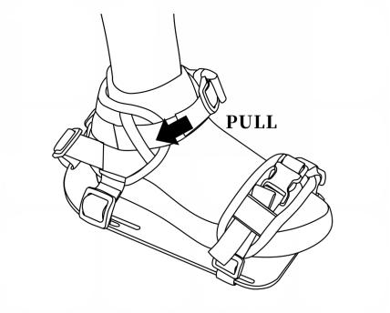
Positioning harness ,belts
Installation and user’s instructions
[ Installation of foot belts ]
Ankle strap
Toe strap
Ankle Strap
Toe Strap
PACKAGE CONTENTS
• Ankle straps, toe straps (may not included )
• Hardware
Step1: Place ankle belts & toe straps on the patient’s ankle and foot, determine the length of adjustment strap. Thread the straps into the corresponding footplate holes (as shown).
Step2: Follow the diagrams below to fix the adjustment strap.
Step3: Connect the ankle strap via the Buckle, and adjust strap to make a snug fit around the ankle and foot by pulling the free end. Be careful not to overtighten.
To avoid unnecessary chafing or rubbing, it is recommended to use the foot belts cover over ankle socks or conventional footwear.

Slide 2
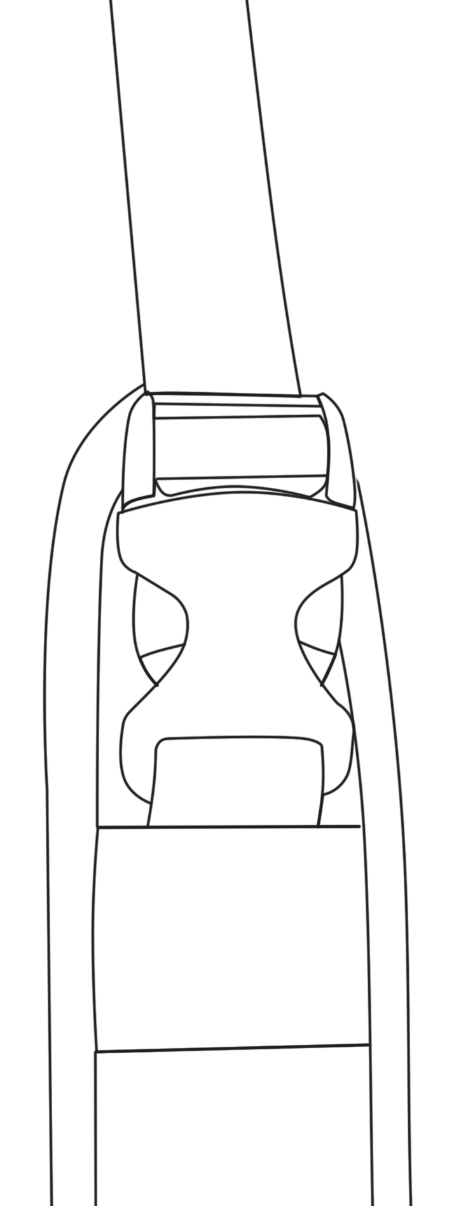
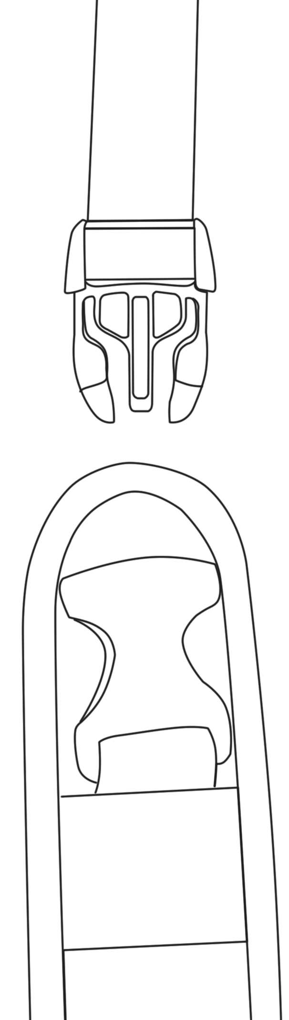

Positioning harness ,belts
Installation and user’s instructions
[ Buckle release ]
PUSH
Plastic buckle
[ Warning ]
Thoroughly read and understand the information in this instructions before attempting to use this product. If the procedures and instructions in this product manual are not followed, it may cause serious injury to the user.
1) WARNING! This product should be prescribed and installed by qualified professionals.
2) WARNING! All positioning harnesses and belts are designed for postural positioning and individual security only, not as a method of restraint. Users must continue to practice regular pressure relief activities and skin integrity checks, not only where this product contacts, but also in primary pressure-bearing areas such as the sacrum, legs, and buttocks. If increased skin redness or irritation occurs, discontinue use and consult your physician or seating specialist. Also, the products need to be adjusted periodically to allow for users’ growth, changes in clothing or in their disability requirements.
3) WARNING!This product should be the first thing to be secured after sitting in the wheelchair, and the last item to be released or removed
before the User leaves the wheelchair. Accidental release of this product can allow the user to slip down or fall forward.
4) WARNING!If the user is trapped in the chair in an emergency, it may be dangerous for the user not to be able to release it on his own.
5) WARNING!If the user's physical or cognitive abilities prevent them from safely operating the harness, then the caregiver must be present at all times during its use. Ensure that all caregivers know how to properly adjust and unclip the product.
[ Maintenance ]:
Inspect this product regularly for signs of wear in the buckles, stitching, webbing & pads. Immediately remove this product from use when any condition develops that might make operation unsafe, contact your supplier for qualified repair or replacement. Do not alter or repair by unqualified persons.Customers modifying or altering our or products, or using them in conjunction with products from other manufacturers, do so at their own risk.
[ Cleaning ]:
Warm machine wash 60°C (140°F). Tumble dry low or drip dry. Do not bleach or iron.
Placing the harness/belt inside a laundry bag to prevent damage to the harness/belt and washing machine/dryer.
[ Warranty statement ]:
This product is warrantied to be free of defects in materials and workmanship for 5 year from the date of purchase for the original consumer purchaser.This warranty does not cover this product failure due to owner misuse or negligence, or normal wear and tear.
[ Disposal ]:
When a product reaches the end of its lifetime, it should be separated by material type so that the parts can be recycled and disposed of safely.
[ Intended use ]
This product should only be used for positioning a person in a wheelchair. Do not use this products for any purpose other than their intended use.

